Slide 1
International Building Code
https://codes.iccsafe.org/content/IBC2021P1
Describe the difference between a building code and the Life Safety Code
Identify construction classifications
Determine the separation requirement between different occupancies

Slide 2
Historic Fire
Cardington

Slide 3
International Building Code
Non structural
  Identify the occupancy classification
  Determine if sprinklered
  Determine construction type
    Building height
    Building area
  Locate building on site
  Determine special occupancy
  Calculate occupant load
    Compliance with means of egress

Slide 4
International Building Code
Non structural
  Identify rated components
  Identify interior finishes
  Identify building systems
  Identify special features
  Identify roof covering
  Determine location of glazings
  Determine accessibility

Slide 5
International Building Code
Structural
  Determine material
    Concrete
    Aluminum
    Masonry
    Steel
    Wood
  Determine design loads
    Live
    Dead
    Environmental

Slide 6
Organization
First digit indicates the chapter
First section of chapter is designated by "01“
  The first section of chapter 3 is section 301
Subsections paragraphs and subparagraphs are indicated by decimal points
  For example, 302.1.1
Heavy vertical lines in the margin is change
Arrow in the margin is deletion
Italicized terms are defined in Chapter 2

Slide 7
Chapters
Chapter 1
  Basically Chapters 1 and 4 in NFPA 101
Chapter 2
  Basically Chapter 3 in NFPA 101
Chapter 3
  Basically Chapter 6 in NFPA 101
Chapter 4
  Basically Chapters 11-42 in NFPA 101
Chapter 7
  Basically Chapter 8 in NFPA 101 with additional design information
Chapter 8
  Basically Chapter 10 in NFPA 101
Chapter 9
  Basically Chapter 9 in NFPA 101
Chapter 10
  Basically Chapter 7 in NFPA 101

Slide 8
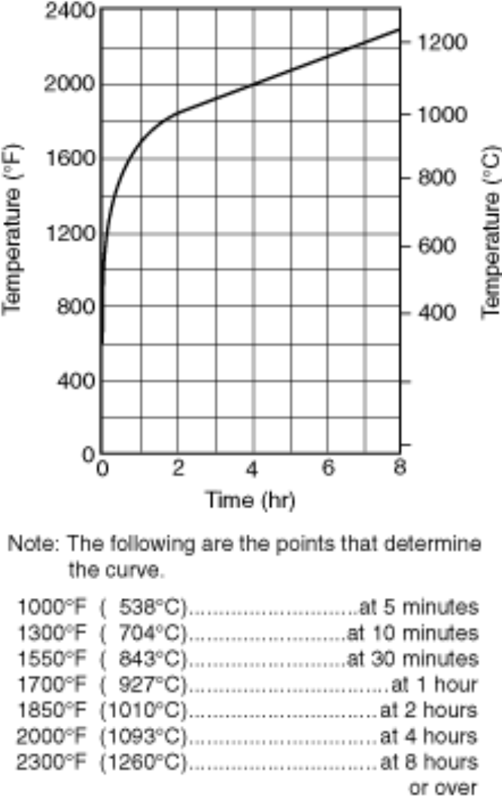
Fire Resistance Ratings
Typically given in units of hours
  Determined by nationally recognized testing laboratories
    Example: Underwriters Laboratories
  Standard time vs. temperature fire exposure

Slide 9
Fire Resistance Requirements
Fire walls typically 3 hour rated
Fire barriers typically 2 hour rated
Required fire resistance ratings for openings
  Tables
  In text

Slide 10
Comparison of Codes
NFPA | IBC
I (443)
I (332) | I-A
II (222) | I-B
II (111) | II-A
II (000) | II-B
III (211) | III-A
III (200) | III-B
 | IV-A
 | IV-B
 | IV-C
IV (2HH) | IV-HT
V (111) | V-A
V (000) | V-B

Slide 11
New Construction Classifications
Type IV has been redefined in the 2021 edition of the codes
  Based on the results of testing
  Allows for taller wood buildings
    Fire resistance ratings required
  New types
    IV-A (fully protected by non combustible material)
    IV-B (limited exposed interior members)
    IV-C (increases for lower hazard occupancies)
  NFPA 5000 no new categories, but allowed to follow Type II rules when having equivalent fire resistance and meeting other requirements

Slide 12
Separation
For incidental accessory occupancy
  (509 and Table 509)
Mixed occupancies
  Accessary (508.2)
  Nonseparated (508.3)
  Separated (508.4 and Table 508.4)

Slide 13
Incidental Use
Table 509

Slide 14
Separated
Table 508.4
As of 2021 filling in both sides of the table
Must use Table 506.2
Options
  No wall required
    Use most restrictive
  Rated wall required
  Not allowed

